Slide 1
GAN Implementation and Regret Minimization
Group - 2 - NgNears
Members
201501037 - Anshul Jethwani
201501043 - Faraaz Kakiwala
201501059 - Jay Modi
201501113 - Hardik Udeshi
1744002 - Parth Gadoya

Slide 2
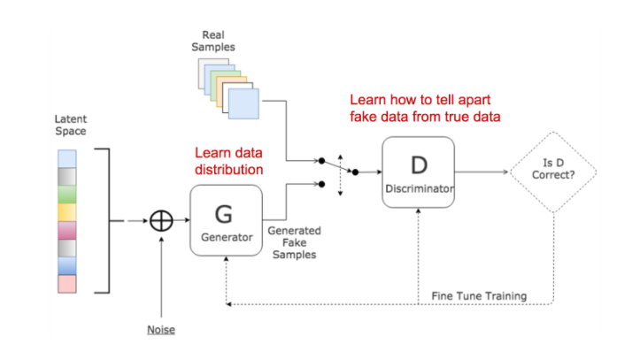
Introduction
GAN: Two neural networks contesting with each other in a zero sum game
Learner makes the decision and the adversary gives back the loss function back to the learner for that particular decision
Notes:
Basically loss function is the price you have to pay for not predicting the values correctly

Slide 3
Motivation
We attempted to generate MNIST dataset using DCGAN by using notion of regret minimization.
Computing global minima for non-convex functions is computationally intractable. The main motivation was to attempt to implement computationally tractable notion of regret minimization in non-convex repeated games like adversarial(GAN) training.
The objective of generative modelling is to help understand the world around us and in that process, create a representation of objects in the world, which enable us to use data better.

Slide 4
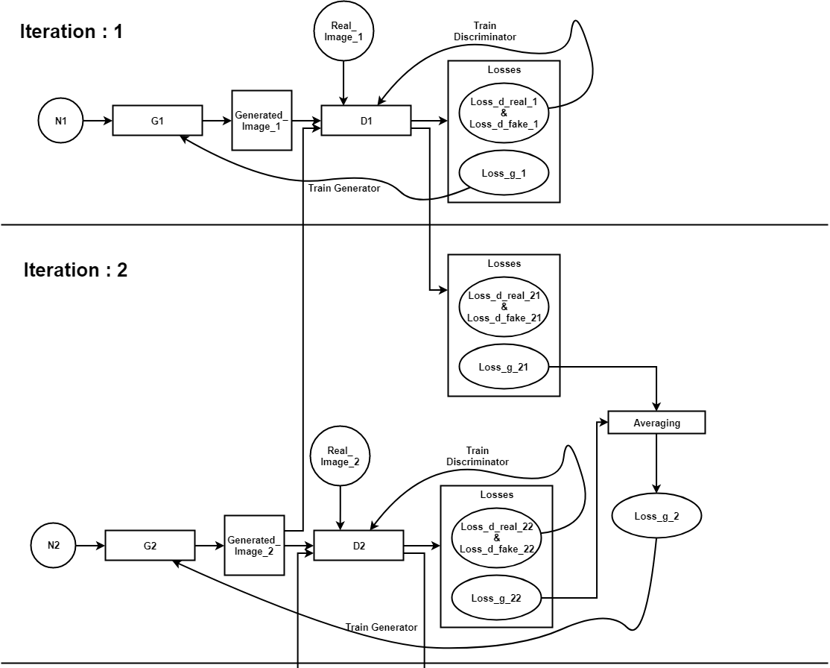
System Architecture

Slide 5
Challenges faced
Understanding regret minimization algorithm
Altering optimizer or multiple loss functions?
Decide application to apply regret minimization approach
Text to Image conversion
Decide type of GAN
Simple GAN
Deep convolutional GAN
Implementation challenges:
Work with tensorflow
Incorporate notion of regret in tensorflow (minimizing average loss over specified window size)
Storing and restoring weights for future experiments

Slide 6
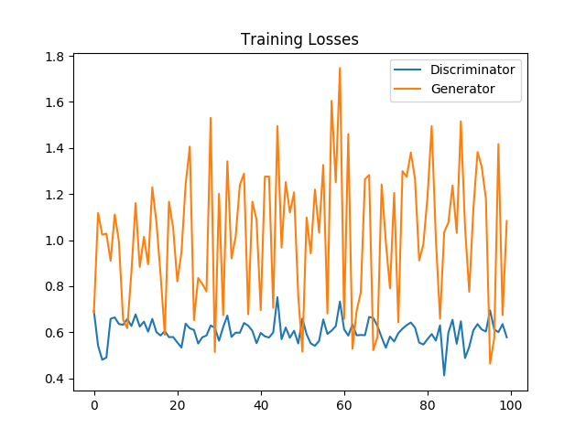
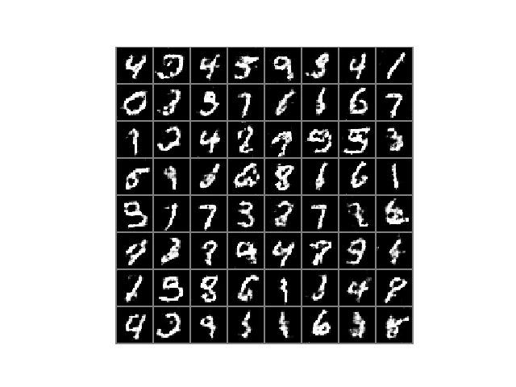
Results: Non-Regret, DCGAN (w=1,GradientDescent)
Notes:
Epoch, regarding loss, regarding image, regarding optimizer, regarding window, regarding GAN

Slide 7
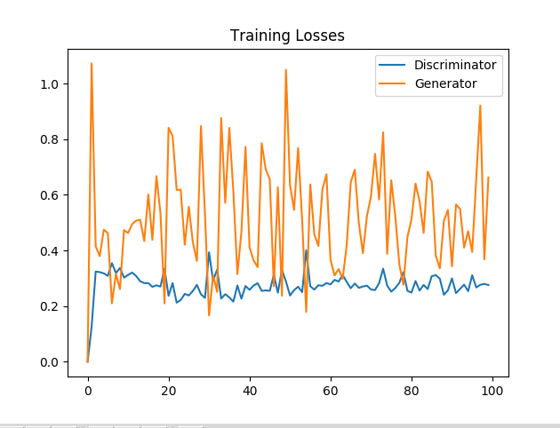
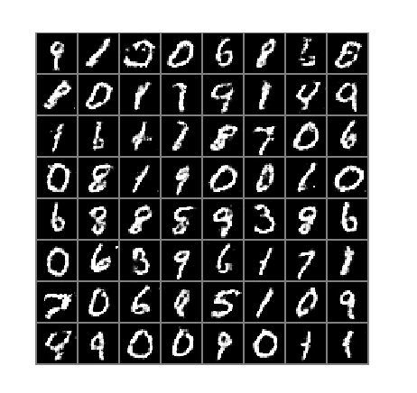
Results: Regret, DCGAN (w=2,GradientDescent)
Notes:
Epoch, regarding loss, regarding image, regarding optimizer, regarding window, regarding GAN

Slide 8
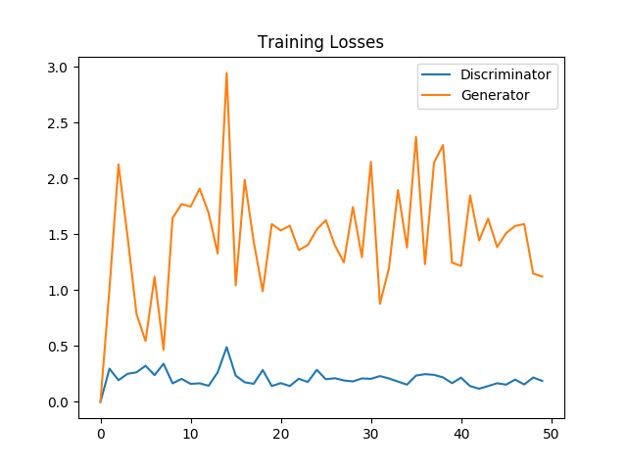
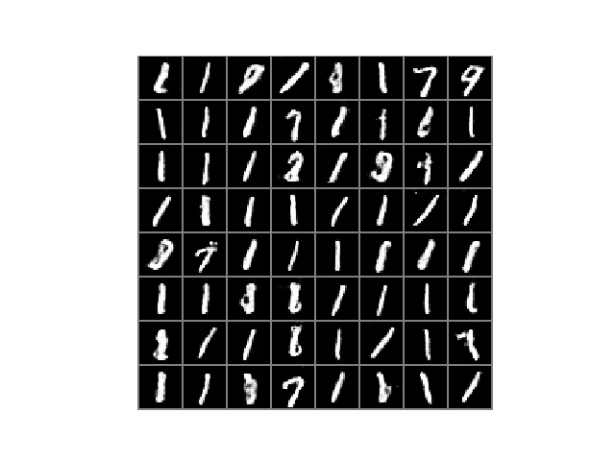
Results: Regret, DCGAN (w=3, RMSProp)
Notes:
Epoch, regarding loss, regarding image, regarding optimizer, regarding window, regarding GAN

Slide 9
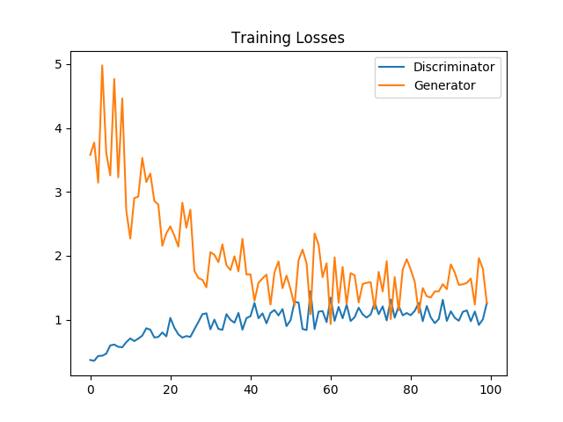
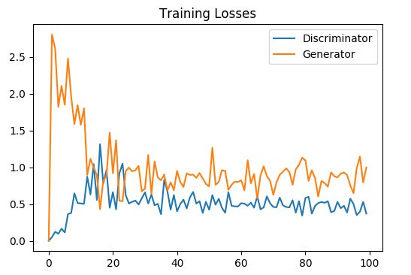
Results: Regret vs Non-Regret, Vanilla GAN (w=2,Adam)
Non-Regret
Regret
Notes:
Epoch, regarding loss, regarding image, regarding optimizer, regarding window, regarding GAN

Slide 10
Analysis
Regret minimization in GAN converge faster(in terms of image) than simple(non-regret) gradient descent in GAN.
RMSProp Optimizer generates better images faster than GradientDescent, but it doesn’t guarantee that the image generated will be better than immediate previous image.
Maximum value of loss in DCGAN is less than the maximum value of loss in Simple GAN.
Value of loss in DCGAN (Regret Minimization) using GradientDescent is almost bound to 1 (it hardly goes beyond 1) while in Non-Regret method many a times it goes beyond 1.

Slide 11
Conclusion
Future scope
For MNIST Dataset, Regret-Minimization method works efficiently in comparison with Non-Regret method.
Implement regret minimization approach for Caltech-UCSD Birds 200’ Dataset for performing “Text to Image conversion”

Slide 12
Thank You!

